Slide 1

Cyber Defense Organization
Fall 2018 - Firewalls

Slide 2
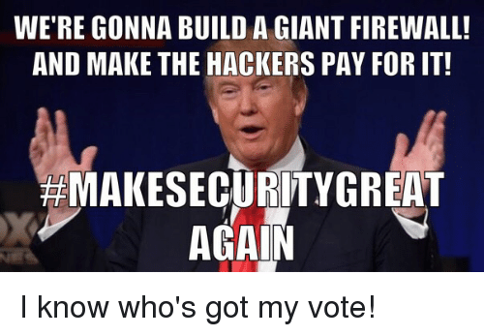
Goals
Introduction to Pfsense Firewalls and rule creation
Basic firewall concepts
Introduction to hardening

Slide 3
About Me
Jonathan Matza
Sophmore majoring in Digital Forensics and Accounting
IT-CTO

Slide 4


What are firewalls
The gods of the network
Filters outgoing and ingoing packets based on a set of rules
Most firewalls double as a router

Slide 5


What we will be using
Open Source, FreeBSD firewall called pfsense
Extremely versatile
Command shell is kind of like linux (a couple of different commands)

Slide 6
Start those VMS!
Open up firewall workshop and firewall workshop 2 (windows server and pfsense)
Password (for windows): bb123#123
Pfsense webgui: username: admin password: pfsense
Why did I choose windows to connect to firewall?

Slide 7
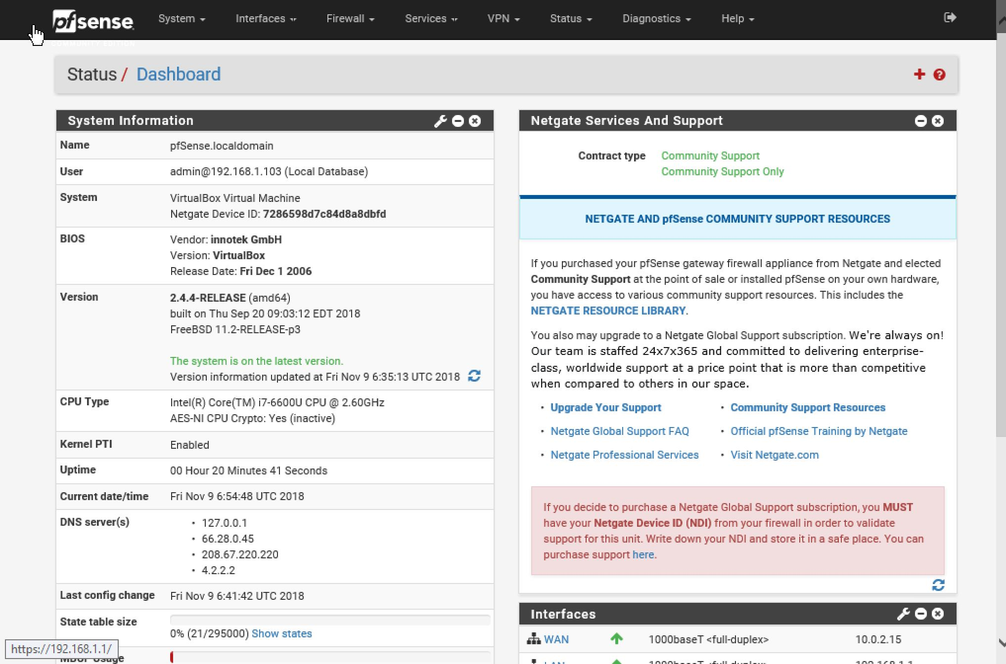
WebGUI
The place to go to more easily navigate the firewall
Uses
Rule Creation
User management
Package installation
Log analysis
Much More
How do you access the web gui?
Important tabs: System, Firewall, and status
Default gateway: Destination of all traffic that is not ssfkljfslkjdsljsdlslsfiajlakj on the same network as the sender

Slide 8
Hardening using the web gui
Big problem: password protection for firewall shell is not a default
What users are on your firewall
Analyzing logs helps with:
Knowing who is logging into your firewall (including the ip address)
Knowing what changes were implemented on firewall
Traffic the firewall rules deny

Slide 9
ANY QUESTIONS??

Slide 10
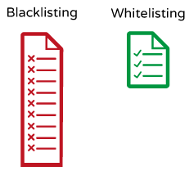
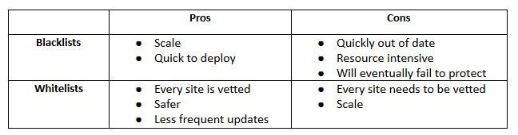
White lists vs black lists
White lists: Only allow traffic that is explicitly allowed
Blacklists: Allows all traffic unless it is explicitly blocked

Slide 11
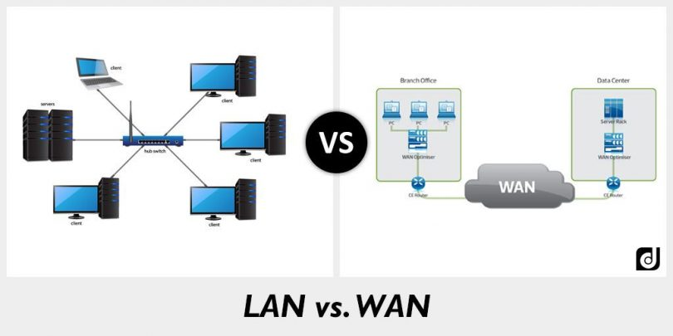
Lan vs Wan
Lan: local area network: think of the room your in
Wan: wide area network: internet is one big wan

Slide 12
Rule Placement
Think of where traffic originates
What is an example of Lan? Wan?

Slide 13
Order of precedence
The order in which firewalls read rules
Goes first to last
Example of firewall without order of precedence: Windows Defender

Slide 14
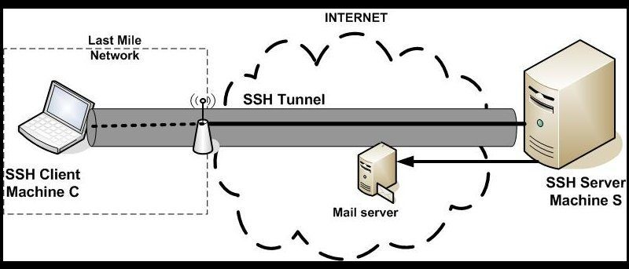
SSH rule Creation
Lets allow the default port of ssh from all computers
What is a port? - Think of it as a unique ID # of a service
What is ssh (Secure Shell)- think remote access
Default port: 22

Slide 15
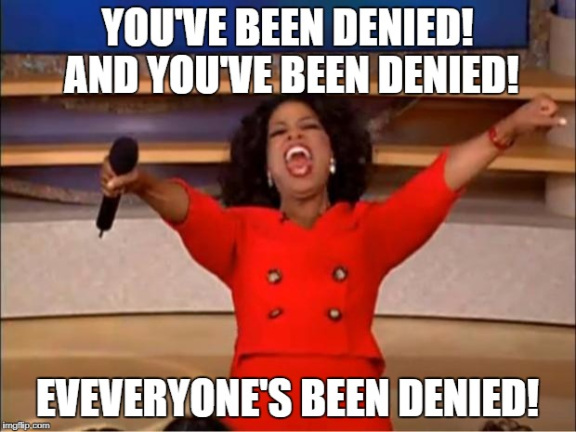
Let's create the core rule for a whitelist
The deny any any rule!
Why doesn’t this overrule your allow rules?
Always put on bottom (order of precedence)

Slide 16
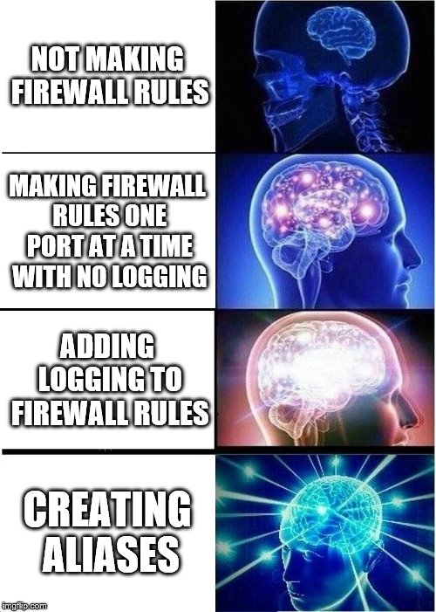
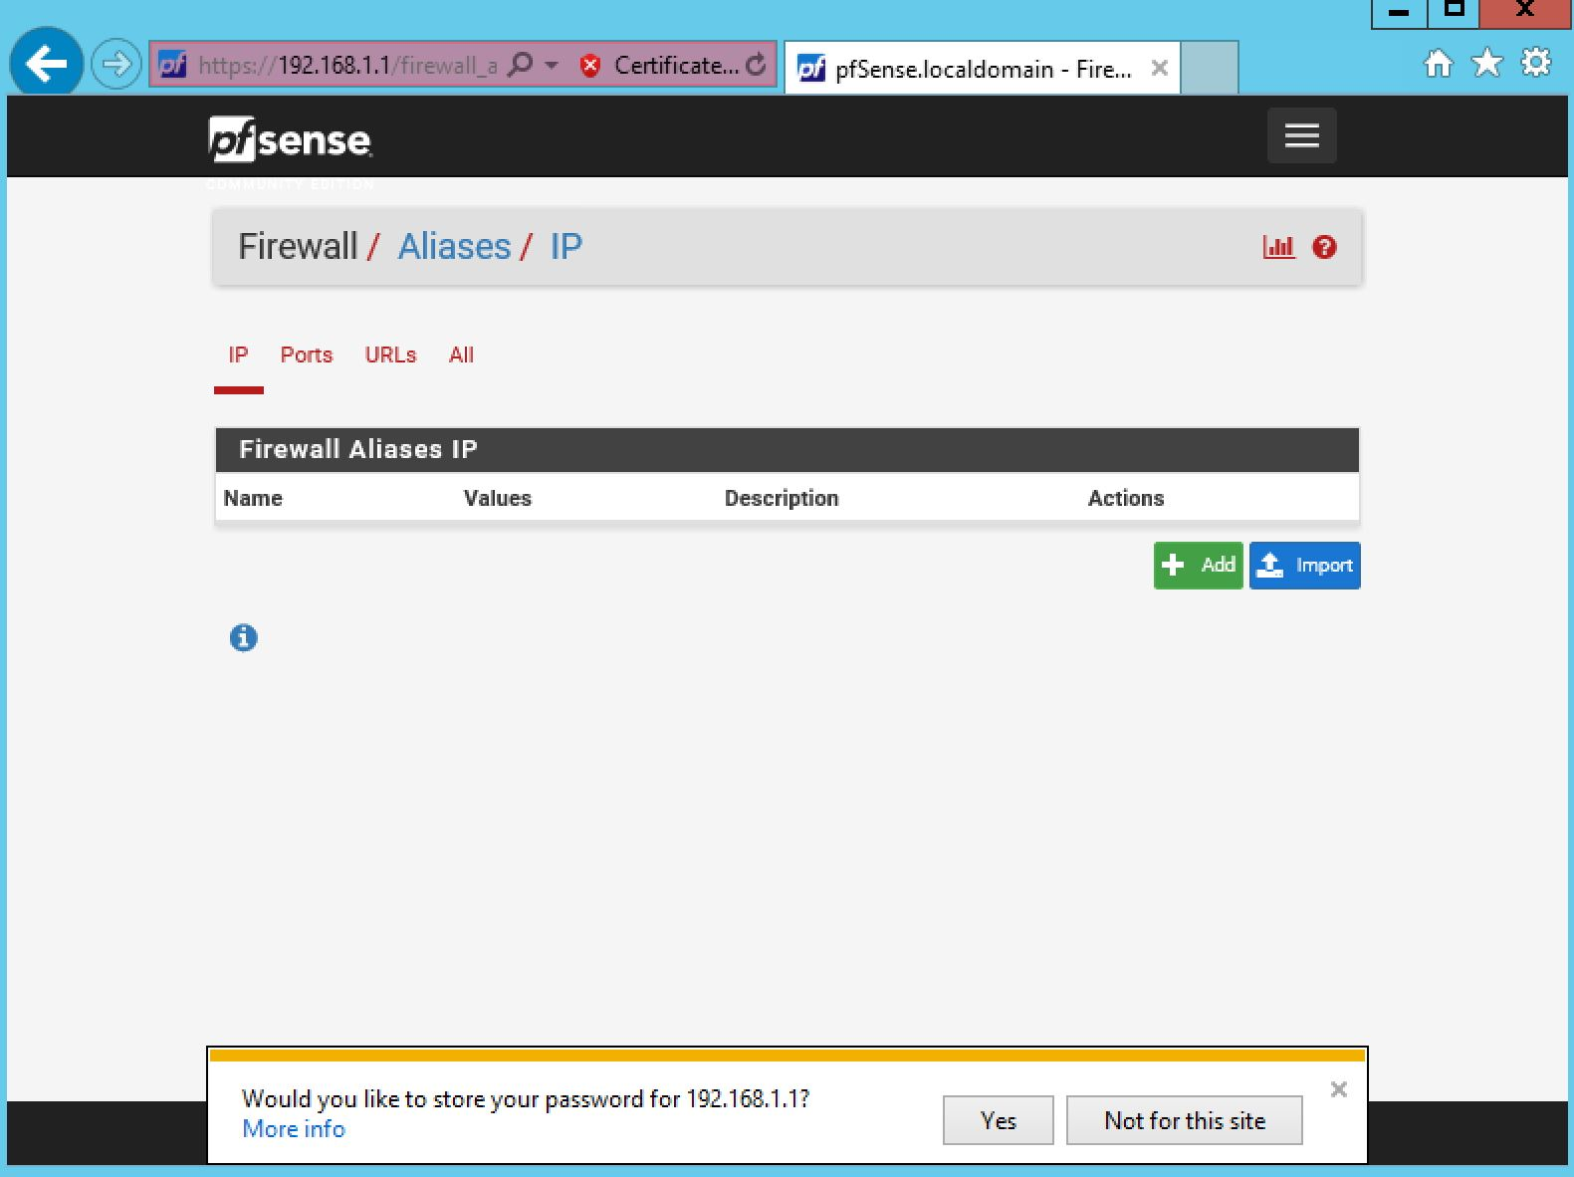
Aliases
Allows you to incorporate multiple ports, Ip addresses, etc into one rule
Good for organization
Follow along while I create an alias for the internet

Slide 17
ANY QUESTIONS??

Slide 18

Do it yourself!
Allow these services:
Pop (hint there are two)
IMAP (hint there are two)
I didn’t give you the ports: Google it!

Slide 19

If we have time
Lets block a website
Situation: people are constantly going on reddit at work
How do we solve that? Firewall rules!
Disclaimer: There are better ways than firewall rules to do this

Slide 20

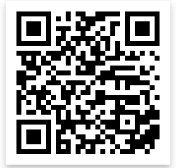
Cya Next week!
Thank you to everyone who filled out the survey!
We made a discord! Keep an eye on email.
Follow us on Twitter? Add on myInvolvement?
Email us if you have an idea for the sweatshirt design!
CCDC! - Monday 7:30
BB123 (Check email).
The Cloud
- Friday 3pm BB123

